Slide 1
Facebook Live Sellers Dataset
Finlatics : ML Project by Subhadip Banik
Email: subhadipbanik9@gmail.com

Slide 2
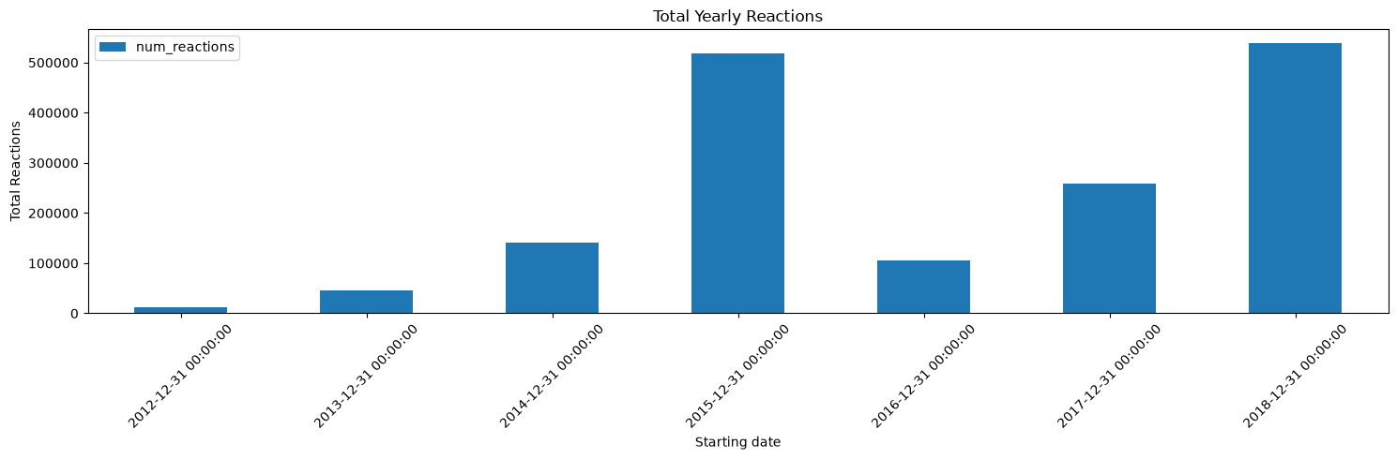
1. How does the time of upload (`status_published`) affect the `num_reaction`?

Slide 3
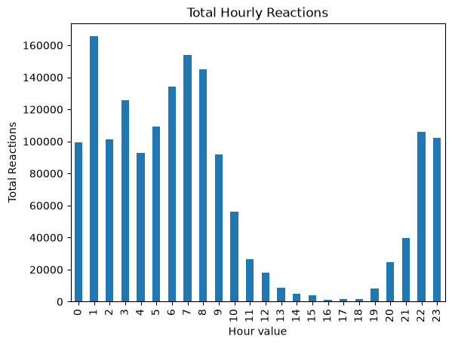
Observations:
Sudden hike of posting in 2015 and 2017-18.
Most of the statuses were posted at midnight.
Skipping office hours

Slide 4
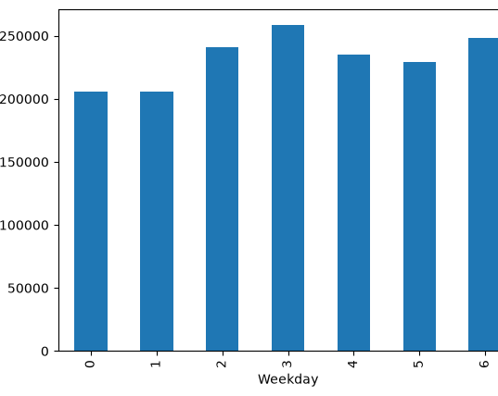
People are posting status on every weekday.
Monday-0
Tuesday-1
Wednesday-2
Thursday-3
Friday-4
Saturday-5
Sunday-6

Slide 5
2. Is there a correlation between the number of reactions (num_reactions) and other engagement metrics such as comments (num_comments) and shares (num_shares)? If so, what is the strength and direction of this correlation?
The number of comments and shares were expected to be proportional to the number of reaction. But I found no correlation.
Giving reaction, commenting and sharing are independent of each other.

Slide 6
3. Use the columns status_type, num_reactions, num_comments, num_shares, num_likes, num_loves, num_wows, num_hahas, num_sads, and num_angrys to train a K-Means clustering model on the Facebook Live Sellers dataset.
Converted all number-string objects to corresponding number (int64)
Photo—0, Video—1, Status—2, Link—3
Used LabelEncoder, StandardScaler, Kmeans modules to train a K-means cluster

Slide 7
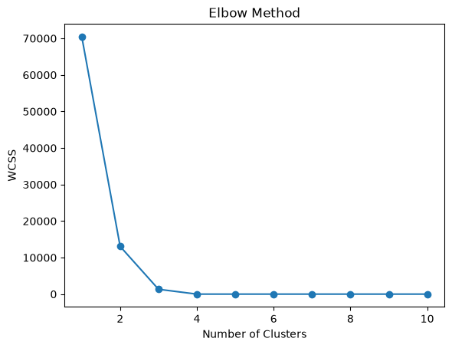
4. Use the elbow method to find the optimum number of clusters.
There is very high value at low number of cluster(s)
WCSS saturates after 4 clusters
Sudden change of gradient (Elbow) at 3 clusters
The optimal number of clusters is 3

Slide 8
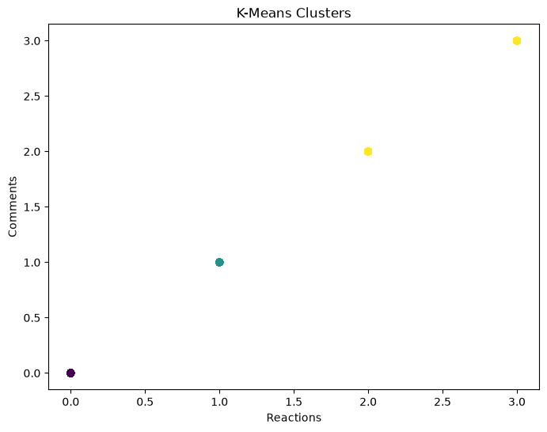
Photo—0
Video—1
Status—2
Link—3

Slide 9
5. What is the count of different types of posts in the dataset?
status_type Count
photo 4288
video 2334
status 365
link 63
Name: count, dtype: int64

Slide 10
6. What is the average value of num_reactions, num_comments, num_shares for each post type?
Type | Photo | Video | Status | Link
‘num_reactions’ | 181.3 | 283.4 | 438.8 | 370.1
‘num_comments’ | 16 | 642.5 | 36.2 | 5.7
‘num_shares’ | 2.6 | 115.7 | 2.6 | 4.4

Slide 11
Thank you.

